Slide 1
Object storage in memory

Slide 2
Variables and Memory
Values of most data types require more than one byte of storage
Several adjacent bytes are then used to hold the data item
The entire chunk of memory that holds the data is called its memory location
The address of the first byte of this memory location is used as the address for the data item
A computer's main memory can be thought of as a long list of memory locations of varying sizes

Slide 3
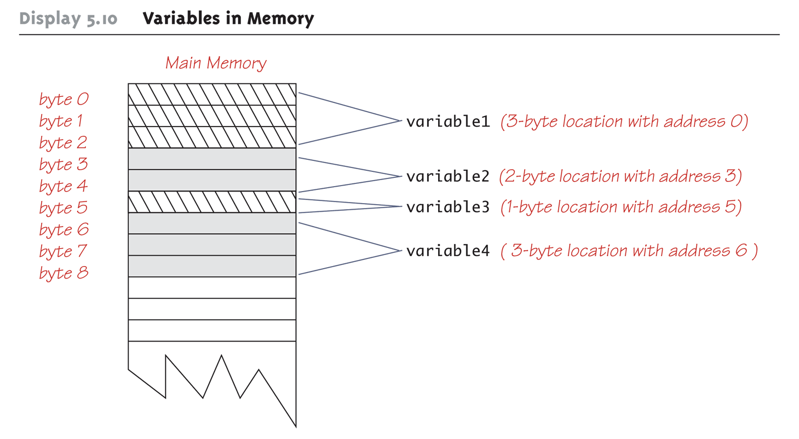
Variables in Memory

Slide 4
References
Every variable is implemented as a location in computer memory
When the variable is a primitive type, the value of the variable is stored in the memory location assigned to the variable
Each primitive type always require the same amount of memory to store its values

Slide 5
References
When the variable is a class type, only the memory address (or reference) where its object is located is stored in the memory location assigned to the variable
The object named by the variable is stored in some other location in memory
Like primitives, the value of a class variable is a fixed size
Unlike primitives, the value of a class variable is a memory address or reference
The object, whose address is stored in the variable, can be of any size

Slide 6
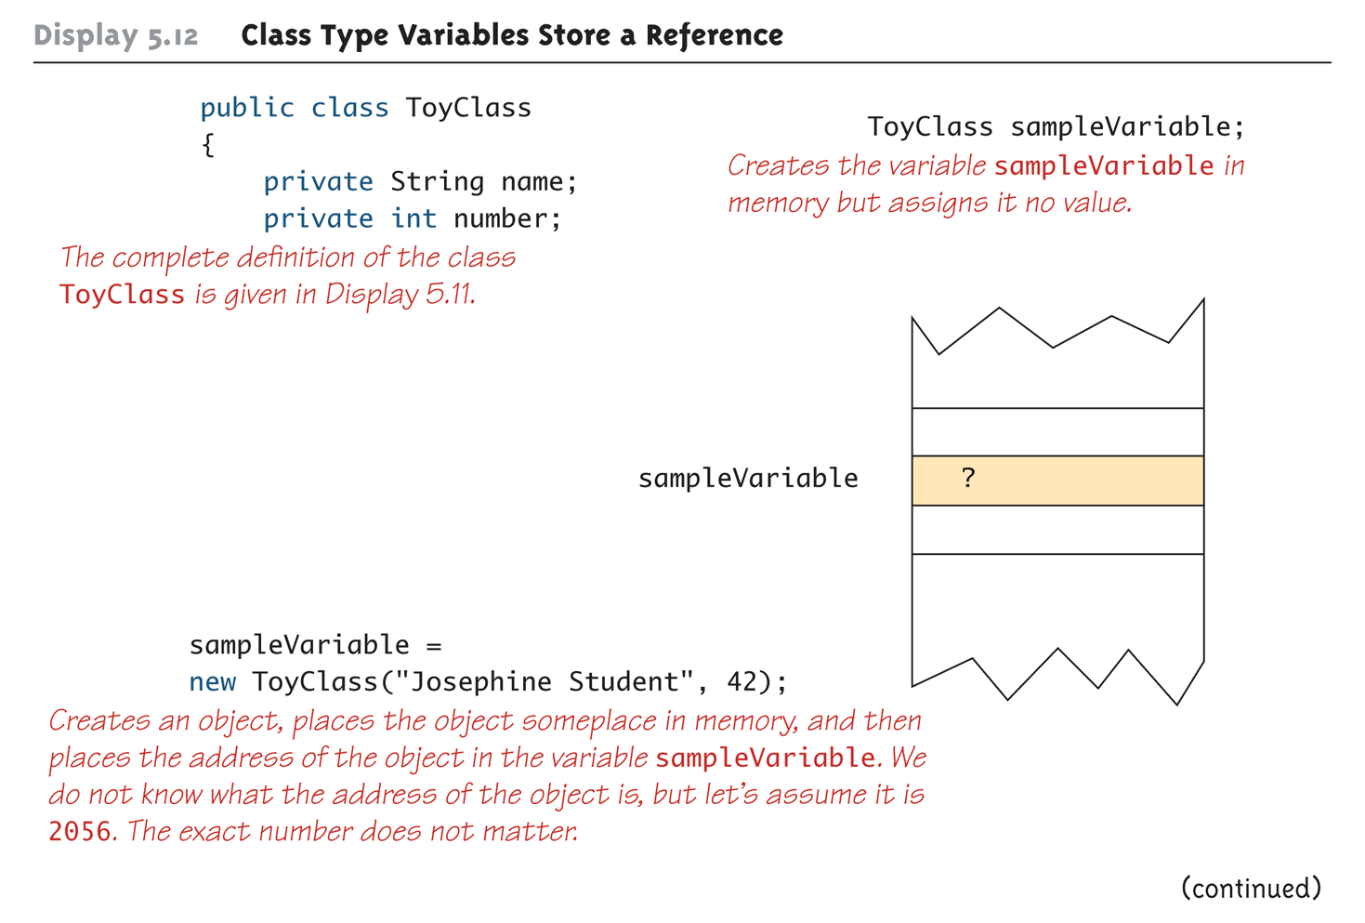
Class Type Variables Store a Reference (Part 1 of 2)

Slide 7
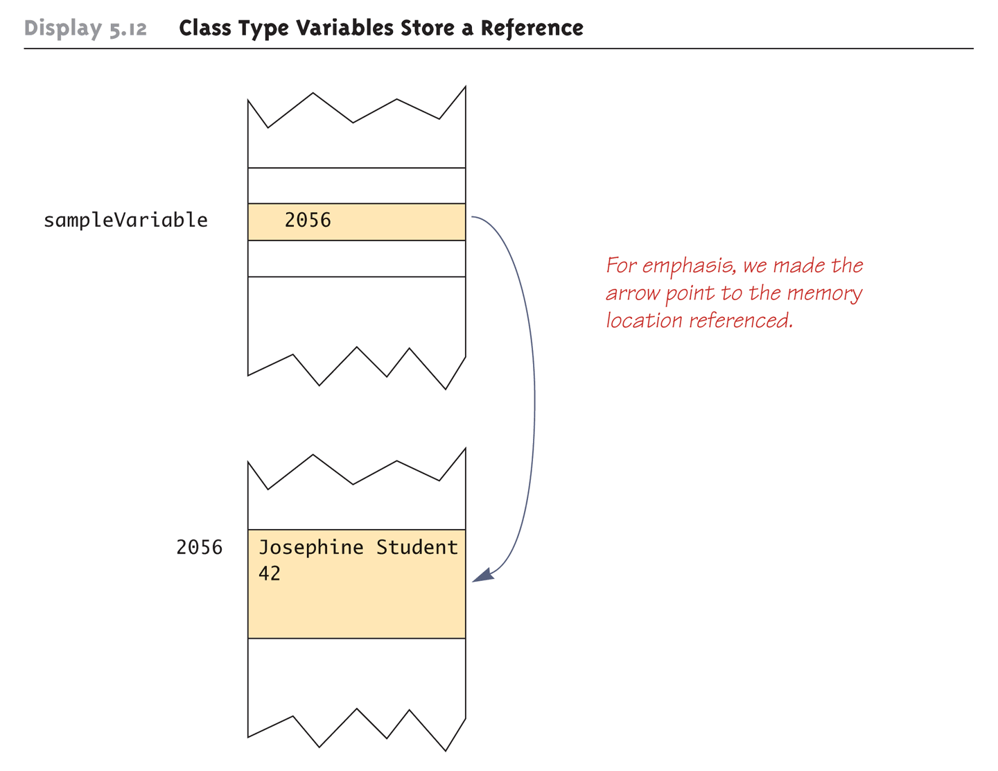
Class Type Variables Store a Reference (Part 2 of 2)

Slide 8
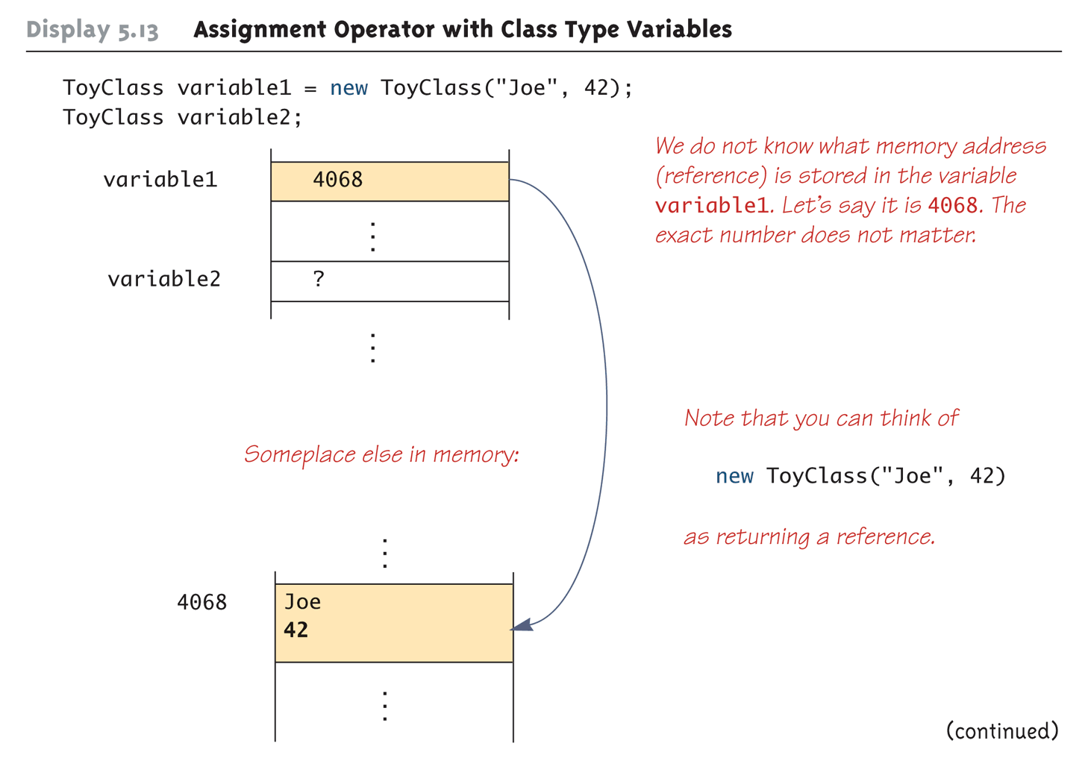
Assignment Operator with Class Type Variables (Part 1 of 3)

Slide 9
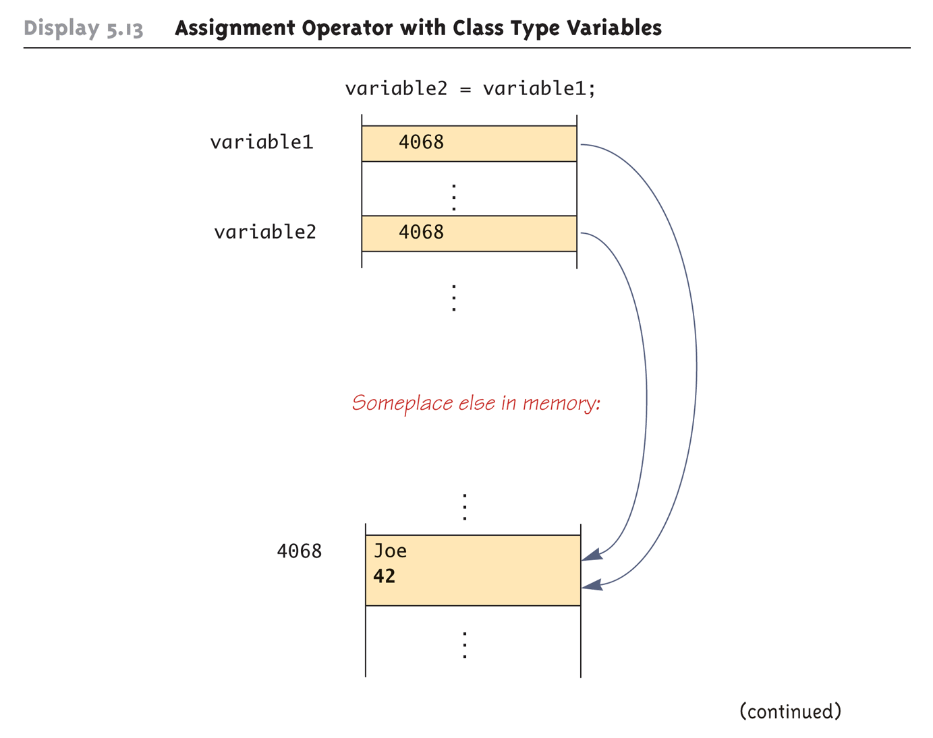
Assignment Operator with Class Type Variables (Part 2 of 3)

Slide 10
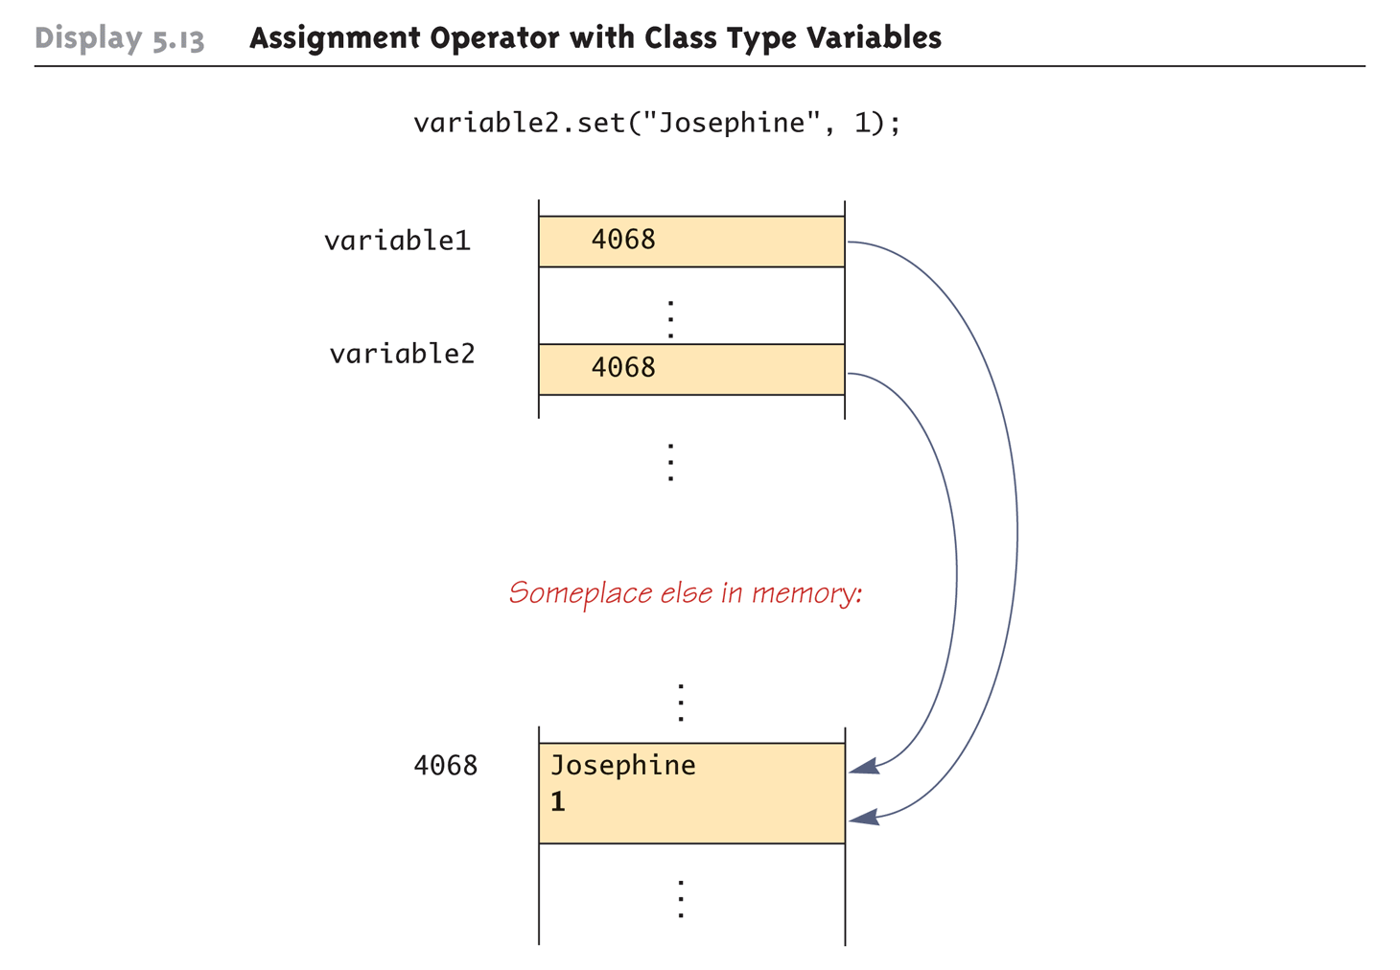
Assignment Operator with Class Type Variables (Part 3 of 3)

Slide 11
References
Two reference variables can contain the same reference, and therefore name the same object
The assignment operator sets the reference (memory address) of one class type variable equal to that of another
Any change to the object named by one of theses variables will produce a change to the object named by the other variable, since they are the same object
variable2 = variable1;

Slide 12
Garbage Collection in java
You all know that an object is created in the memory using new operator.
Constructor is used to initialize the properties of that object.
When an object is no more required, it must be removed from the memory so that that memory can be reused for other objects.
Removing unwanted objects or abandoned objects from the memory is called garbage collection (GC).

Slide 13
Garbage Collection in java
Abandoned objects or dead objects are those objects which does not have live references.
Circle ci = new Circle (4);
// the new Circle object is reachable via the reference in 'i'
ci = null;
// the Circle object is no longer reachable.

Slide 14
Garbage Collection in java
public class Test
{
public static void main(String[] args)
{
//Creating two instances of class A
A a1 = new A();
A a2 = new A();
//Assigning a2 to a1
a1 = a2;
//Now both a1 and a2 will be pointing to same object
//An object earlier referred by a1 will become abandoned
}
}

Slide 15
Finalization(optinal)
Just before destroying an object, Garbage Collector calls finalize() method on the object to perform cleanup activities. Once finalize() method completes, Garbage Collector destroys that object.
finalize() method is present in Object class with the following prototype.
protected void finalize() throws Throwable

Slide 16
END

